Slide 1
Unit-3 Exception Handling and I/O Streams

Slide 2
Exception: Definition
An exception is
an exceptional condition/
problem/
abnormal condition/
an error
that may arise during the execution of program.
An Error that occurs in a code sequence at run time.
Computer languages not support exception handling.
Errors must be checked and handled manually.
Java’s exception handling support run-time error management to avoid these problems.

Slide 3
Exception handler
When an exceptional events occurs in java, an exception is said to be thrown.
The code that's responsible for doing something about the exception is called an exception handler.
Exception handler is block of code that is executed automatically when an error occurs.

Slide 4
Exception class Hierarchy
In Java, all exceptions are represented by classes.
All exception classes are derived from a class called Throwable.
When an exception occurs in a program, an object of some type of exception class is generated.
Only the object of Throwable class or its subclasses can be thrown.
All exception types are subclasses of class Throwable.
It is at the top of exception class hierarchy.

Slide 5
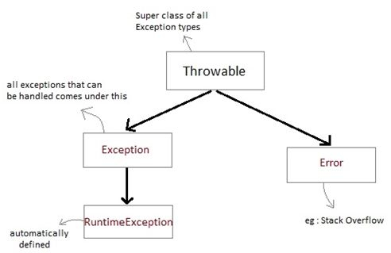
Exception class Hierarchy

Slide 6
Error
The Java Virtual Machine can generate an exception in response to some internal error is called as Error.
Errors that occur in the Java virtual machine itself, and not in program.
Program won’t handle these types of exceptions.
These types of exceptions are beyond your control.

Slide 7
Exception
Errors that result from program activity are represented by subclasses Exception.
Exceptions are generated by errors in program code.
Need to handle these exceptions.
Example-
-divide-by-zero, array index out-of-bounds
-array boundary, file errors
Runtime Exception
An important subclass of Exception.
It is used to represent various common types of run-time errors.

Slide 8
Exception Handling Mechanism
In java, exception handling is done using five keywords-
1. try
2. catch
3. throw
4. throws
5. finally
Exception handler executes a program when exception occurs.

Slide 9
try
Try is used to guard a block of code in which exception may occur.
This block of code is called guarded region.
Program statements that want to monitor for exceptions are contained within a try block.
If an exception occurs within try block, it is thrown.
catch
If an exception occurs in guarded code, the catch block that follows the try is checked.
Code can catch an exception using catch and handle it in some rational manner.

Slide 10
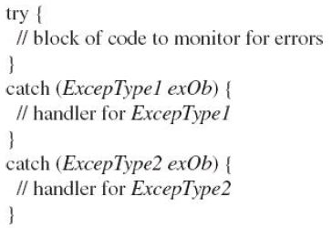
Using try and catch
At the core of exception handling are try and catch.
These keywords work together; can’t have a catch without a try.
General form:

Slide 11
Example using Try and catch
class Excp{
public static void main(String args[]){
int a,b,c;
try{
a=0; b=10;
c=b/a;
System.out.println("This line will not be executed");
}
catch(ArithmeticException e){
System.out.println("Divided by zero");
}
System.out.println("After exception is handled");
} }

Slide 12
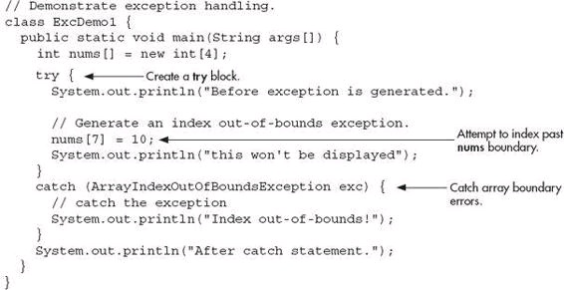

Slide 13
Nested try statement
try statement can be nested inside another block of try.
Nested try block is used when a part of a block may cause one error while entire block may cause another error.
If inner try block does not have a catch handler then the outer try catch block is checked for match.
In nested try catch, the inner try block uses its own catch block as well as catch block of the outer try, if required.

Slide 14
class Excep{
public static void main(String[] args){
try{
int arr[]={5,0,1,2};
try{
int x=arr[3]/arr[1];
}
catch(ArithmeticException ae){
System.out.println("divide by zero");
}
arr[4]=3;
}
catch(ArrayIndexOutOfBoundsException e){
System.out.println("array index out of bound exception");
}
} }

Slide 15
Multiple catch blocks
A try block can be followed by multiple catch blocks.
We can have any number of catch blocks after a single try block.
If an exception occurs in the guarded code the exception is passed to the first catch block in the list.
If the exception type of exception matches with the first catch block it gets caught, if not the exception is passed down to the next catch block.
This continue until the exception is caught or falls through all catches.

Slide 16
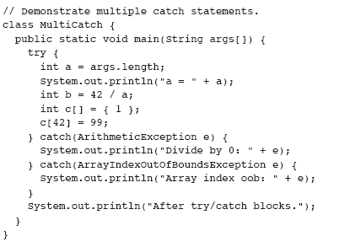

Slide 17

One more example:

Slide 18
Throwing an Exception
throw
System-generated exceptions are automatically thrown by the Java run-time system.
To manually throw an exception, use the keyword throw.
General form:
throw exceptOb;

Slide 19
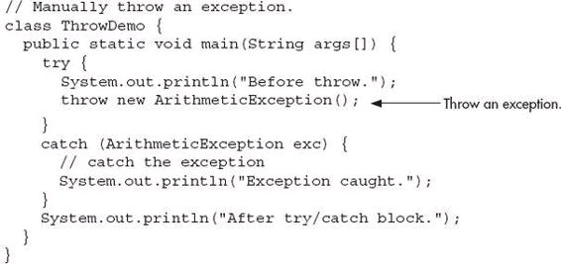
Example

Slide 20
Rethrowing an Exception
An exception caught by one catch statement can be rethrown so that it can be caught by an outer catch.
Rethrowing is used to allow multiple handlers access to the exception.
-One exception handler manages one aspect of an exception.
-Second handler copes with another aspect.
When rethrow an exception, it will not be recaught by the same catch statement.
It will propagate to the next catch statement.

Slide 21
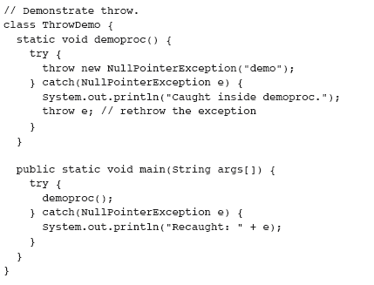

Slide 22
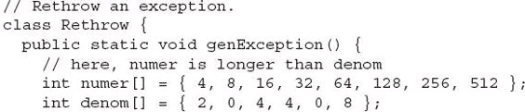
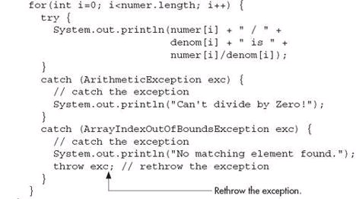
One more Example

Slide 23
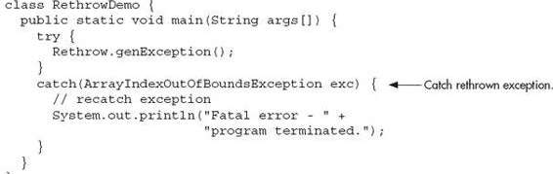

Slide 24

throws
If a method generates an exception that it does not handle, it must declare in a throws clause.
General form of a method that includes a throws clause:
except-list is a comma-separated list of exceptions that the method might throw outside of itself.

Slide 25
throws
In some cases, an exception that is thrown out of a method must be specified as such by a throws clause.
A throws clause lists the types of exceptions that a method might throw.
It is necessary for all exceptions, except those of type Error or RuntimeException,
All other exceptions that a method can throw must be declared in the throws clause.
If they are not, a compile-time error will result.

Slide 26
class ThrowsDemo {
static void throwOne() throws IllegalAccessException {
System.out.println("Inside throwOne.");
throw new IllegalAccessException("demo");
}
public static void main(String args[]) {
try {
throwOne();
}
catch (IllegalAccessException e) {
System.out.println("Caught " + e);
} } }

Slide 27
finally
Any code that absolutely must be executed upon exiting from a try block is put in a finally block.
finally creates a block of code that will be executed-
-after a try /catch block has completed
-before the code following the try/catch block.
The finally block will execute whether or not an exception is thrown.
If an exception is thrown, the finally block will execute even if no catch statement matches the exception.

Slide 28
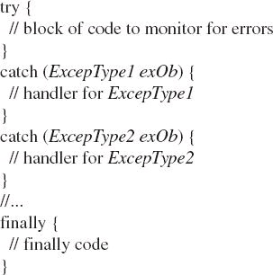
Define a block of code that will execute when a try/catch block is left.
Include a finally block at the end of a try/catch sequence.

Slide 29
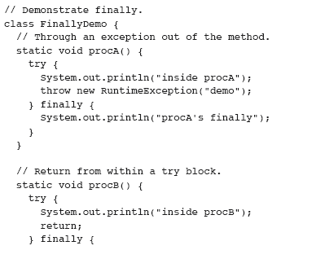

Slide 30
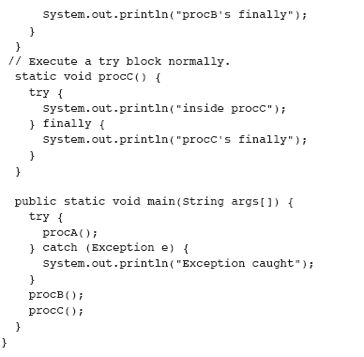

Slide 31
OUTPUT

Slide 32
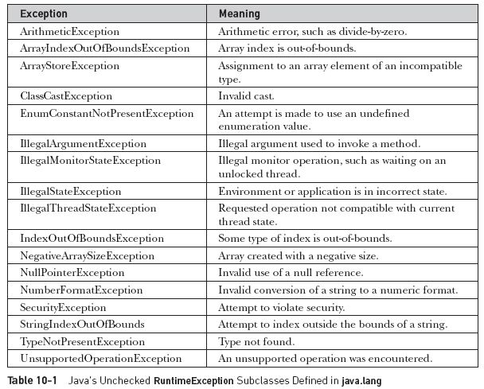

Slide 33
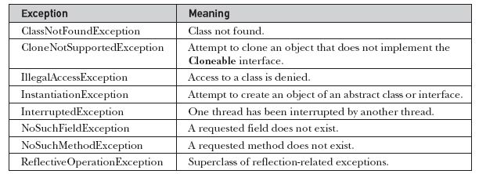
Java’s Built-in Exceptions

Slide 34
Creating Own Exception Subclasses
Java’s built-in exceptions handle most common errors.
Create Exception types
-To handle situations specific to your application.
-To manage errors that relate specifically to your application.
Define a subclass of Exception (subclass of Throwable)
Exception class does not define any methods of its own.
It does inherit those methods provided by Throwable.
All exceptions have the methods defined by Throwable.
We can override one or more of these methods in exception subclasses that you create.

Slide 35
Exception defines four public constructors.
-Two support chained exceptions.
-The other two are :
1. Exception( )
2. Exception(String msg)
The first form creates an exception that has no description.
The second form specify a description of the exception.
Specifying a description when an exception is created is often useful.

Slide 36
toString( )
toString( ) defined by Throwable (inherited by Exception)
First displays the name of the exception followed by a colon, which is then followed by your description.
By overriding toString( )
We can prevent the exception name and colon from being displayed.
This makes for a cleaner output.

Slide 37
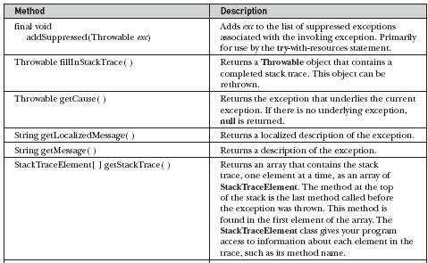
The Methods Defined by Throwable

Slide 38
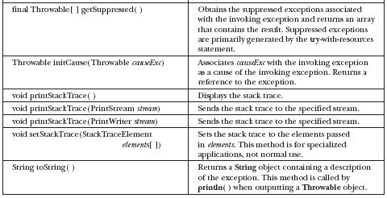

Slide 39
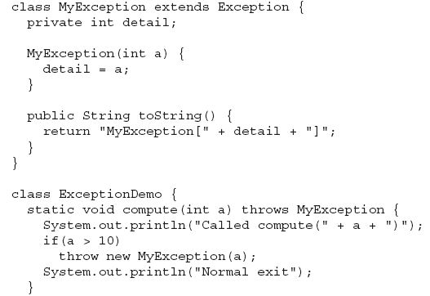

Slide 40
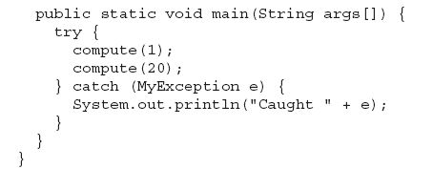

Slide 41

Output

Slide 42
Chained Exceptions
The chained exception feature allows to associate another exception with an exception.
This second exception describes the cause of the first exception.
Example-
Method throws an ArithmeticException
Because of an attempt to divide by zero.
The actual cause of the problem was that an I/O error occurred.

Slide 43
To allow chained exceptions-
-two constructors and
-two methods were added to Throwable.
The constructors are:
-Throwable(Throwable causeExc)
-Throwable(String msg, Throwable causeExc)
first form, causeExc is the exception that causes the current exception.
causeExc is the underlying reason that an exception occurred.
The second form allows to specify a description at the same time that you specify a cause exception.

Slide 44
The chained exception methods supported by Throwable-
-getCause( )
-initCause( )
Throwable getCause( )
Throwable initCause(Throwable causeExc)
The getCause( ) method returns the exception that underlies the current exception.
If there is no underlying exception, null is returned.
The initCause( ) method associates causeExc with the invoking exception and returns a reference to the exception.

Slide 45
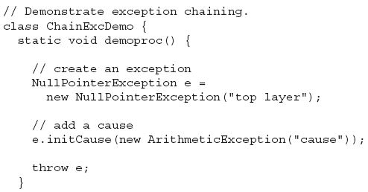

Slide 46
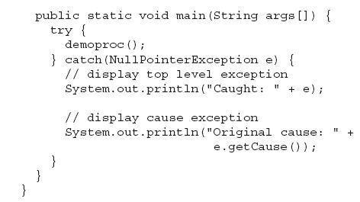

Slide 47
Output
Caught: java.lang.NullPointerException: top layer
Original cause: java.lang.ArithmeticException: cause

Slide 48
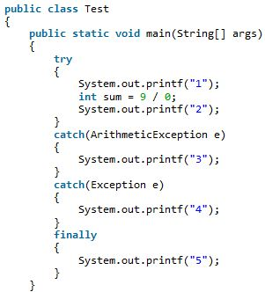

Slide 49
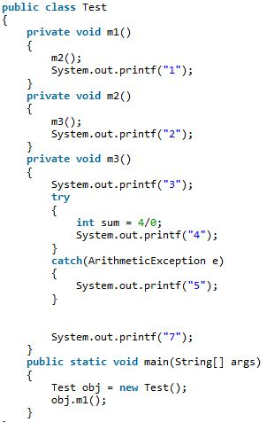

Slide 50
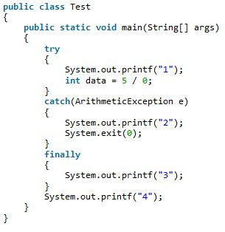

Slide 51
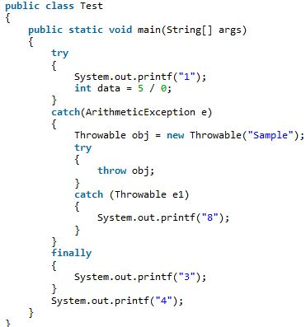

Slide 52
